Slide 1
Post-16 – Which way now?

Slide 2
Sixth Form
College
What can I do from 16-18?
Employment with Training

Slide 3
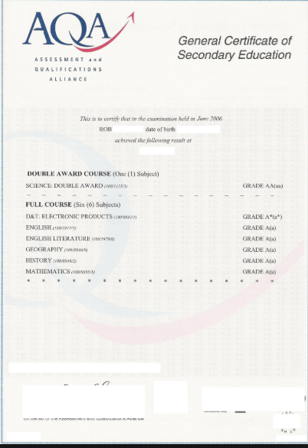

Slide 4
28th September
Letters and post-16 options booklets sent home
w/c 8th October
Start to complete UCAS Progress profiles in form time on Thursdays
11th December
Parents Evening and Post-16 Provider Fair @ TRGA
26th-30th November
Trips arranged to local sixth forms and colleges with small groups of students
3rd and 4th October
Skills Show trip @ Elland Road and UCAS Progress introductory session
14th December
Final deadline for submitting sixth form/college applications

Slide 5
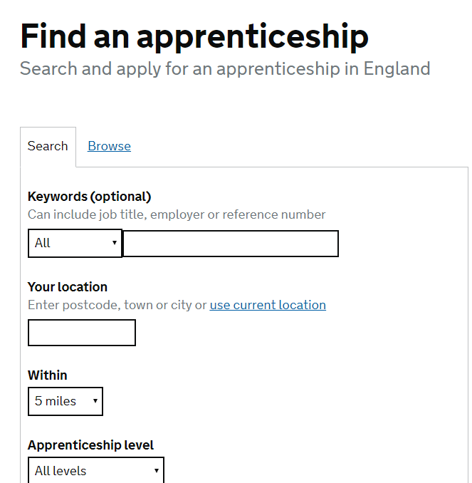
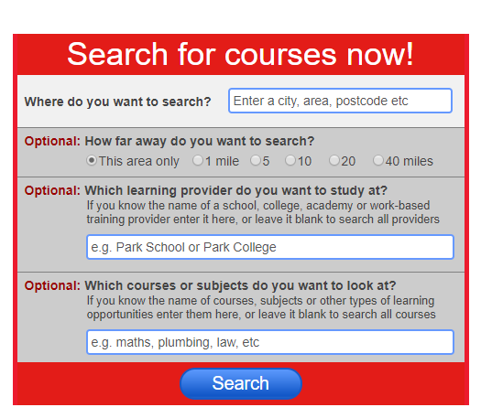

Slide 6
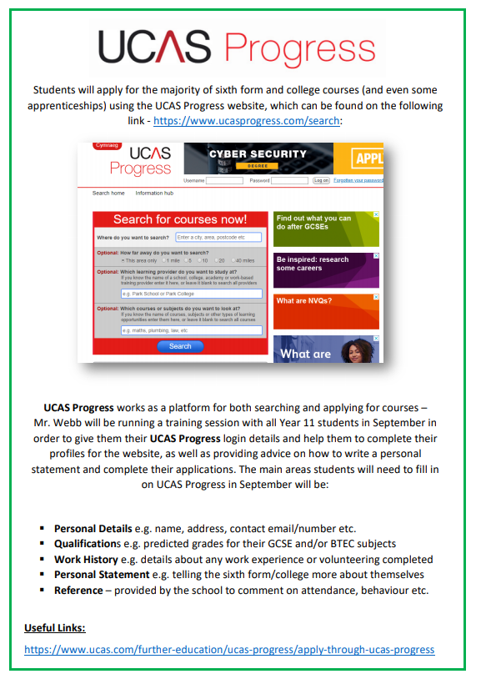
Post-16 Options Booklet

Slide 7
Careers guidance meetings – every student in Year 11 will have at least one appointment this year
Lunchtime drop-in (13:05-13:45)
Careers Fair
Uni/College Visits
Employability Workshops
CV/Application Support
Interview Preparation
Parents Evenings

