Slide 1
Work Experience
Pete Small
The YETI Ltd

Slide 2
This is an opportunity…
You don't necessarily have to choose something that you want to do as a job when you leave school
The overall aim is for you to experience life in an adult workplace
Be positive – work experience, whatever the placement, is an opportunity to learn new things and find things out about yourself

Slide 3
Where to start…
What do I want to do when I leave school?
What am I good at?
What are my interests and hobbies?
What new skills would I like to learn?
What jobs have I seen people doing that I think look interesting?

Slide 4
Where to start…
Now look at your list and try to reduce it to 3 or 4 possibilities. The following questions may help you with this:
Is this a realistic work placement for a 14/15 year old?
What sort of work am I likely to be doing?
Will there be a variety of tasks to do or could I become bored?
Would I experience skills & tasks related to a profession I am interested in?
Could this be an opportunity to try something completely new?

Slide 5
How to find one…

Slide 6
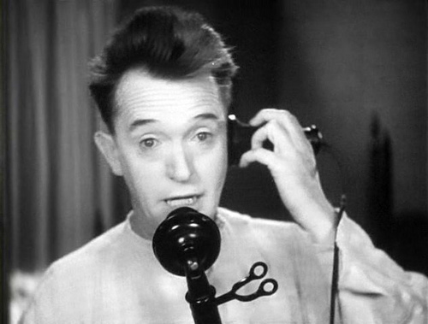
Where to start…
In person
By phone
By letter
By email

Slide 7
theyetiadvises
@yetichorus
theyetipins
www.theyetiltd.com

