Slide 1
The National Retraining Scheme

Slide 2
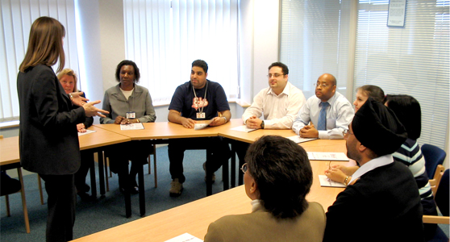
What is the National Retraining Scheme and why do we need it?
The Government announced at the 2017 Autumn Budget that it would introduce a National Retraining Scheme, to help workers retrain as the economy changes.
The Scheme is being driven by National Retraining Partnership with the CBI, TUC and Government.
This was followed up in the 2018 Autumn Budget, were the Chancellor announced a £100 million commitment to start the initial roll out of the National Retraining Scheme. This funding will allow us to start delivering initial elements of the service to the public from this summer and allow us to substantively test, evaluate and learn as we build the service.
KEY FACTORS:
The world of work is changing, whether that be through technological change, longer working lives and long-standing low productivity.
In particular, although automation will bring opportunities, it has the potential to cause a significant impact on the economy - some studies have shown that up to 35% of jobs are at risk of automation in the next 20 years.
Most low skilled individuals who are likely to be affected by automation are not taking steps to guard against these risks. Specifically, they are not aware of these risks or able to take the opportunities available to retrain and redirect their careers.
Proportion of jobs at risk of being automated over the next 10-20 years
OBJECTIVES OF THE SCHEME
The Scheme will succeed and deliver good value for money if:
It takes individuals at risk of their jobs changing or disappearing as a result of automation…
…facilitates them gaining the skills they need to move into a new occupation…
…and successfully allows them to move into more secure, better jobs
Frey and Osborne, 2014: ‘Agiletown - London Futures’
FOR DISCUSSION - NOT A STATEMENT OF GOVERNMENT POLICY

Slide 3
Our user research shows people face a number of barriers, but that linking training to real world employment outcomes is a strong motivator
WHO WE ARE AIMING TO HELP
Adults aged 24+…
… who are in work…
… who don’t have a degree…
… with a particular focus on those jobs at risk of automation.
In response we are developing the Scheme using the user-focused test, build and iterate approach, and are delivering pilots to look at engagement, flexible delivery and the impact of cost subsidy.
Our user research with potential adult learners, employers and providers has delivered initial findings for what users would need from a retraining scheme.
Findings
People want a job, not a training course and most wouldn’t leave a job to train.
People are not aware their jobs are at risk.
Online training often meets users needs for flexibility, but our testing has shown that our user base lacks confidence in using it.
Most individuals would pay or co-fund training if it led to a job but most would not accept a drop in salary (some would consider a drop for a year).
Employers will want any scheme to integrate with existing recruitment processes.
Alongside our user research, we are conducting a number of pilots that will help inform the design and testing of the Scheme
‘Cost and Outreach Pilots’ - In five local areas across England, we are testing how successful marketing and subsidies are in overcoming barriers to attitude and cost for adult learners.
Flexible Learning Fund – Through delivering 30 projects within this fund, we are testing how we can overcome barriers relating to the accessibility of learning for adults.
Construction Skills Fund - Launched in June 2018, this will support and incentivise innovative and employer-led approaches to construction training over the next two years.
Adult Learning Technology Innovation Fund – In June 2019, recently launched the Adult Learning Technology Innovation Fund to stimulate the development of Artificial Intelligence in the delivery of online learning for individuals who are likely to form part of the NRS target group.

Slide 4
Using what we have learnt, we have developed our vision of what the Scheme could look like in steady state

Slide 5
The first element we are currently planning to release in Summer is ‘Get help to retrain’
9

Slide 6
As we roll out ‘Get help to retrain’, we will also be developing and designing other products within the Scheme
We are proposing to roll out initial elements incrementally, testing and iterating our approach
We will be able to quickly act on user feedback and make changes (grow what works, stop what doesn’t), helping to ensure this scheme succeeds where previous schemes have failed.
We will be able to release parts of the service into Public Beta and Live sooner where we are confident that this will unlock value for users of the Scheme, adding further features as they are developed, tested and iterated.
Using this approach will also give us more flexibility to respond to labour market changes and the considerable uncertainty around the impact of automation and wider technological changes.
The key next stages will be:
*For illustrative purposes
Develop prototypes of the Scheme to test key assumptions (Nov 18-Feb 19):
Develop a range of prototypes of parts of the service that can be tested and iterated with a closed group of workers.
Release of first elements of the Scheme (Summer 19: 6-12 months):
Release, test and iterate initial elements of the service with a small group of users, developing further products within the service and focussing on our priority group.
Roll out elements to a wider group of users (~2020 onwards):
Roll out elements of the service to a wider group of users, working towards a live service that is open to all eligible users.
Complete
New releases

Slide 7
We keen to remain engaged with you while we develop and deliver these next stages
If you are interested in helping us test the next stages of the National Retraining Scheme or would like to find out more please contact:
michael.carney@education.gov.uk

